Slide 1
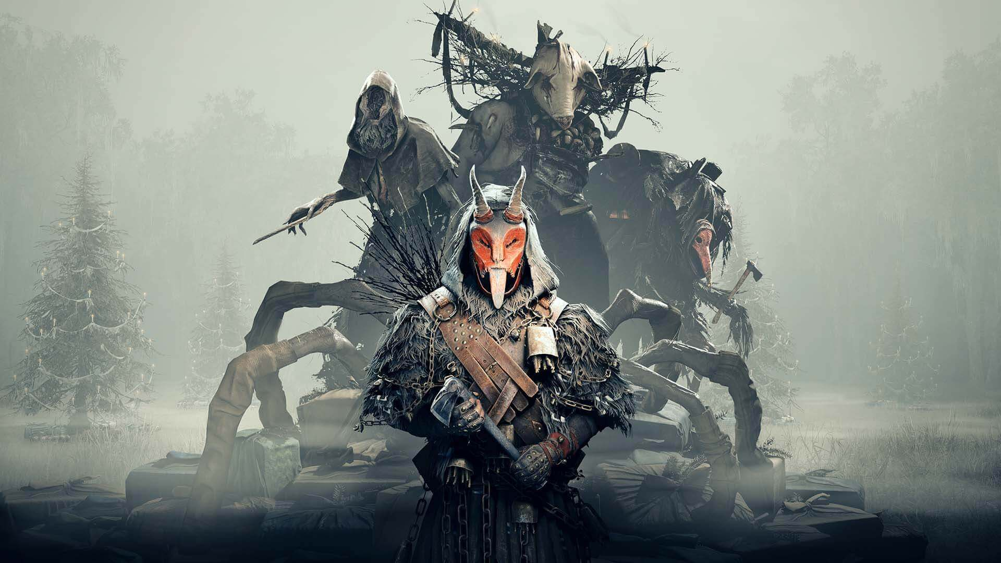

Slide 2
Gameplay

Slide 3
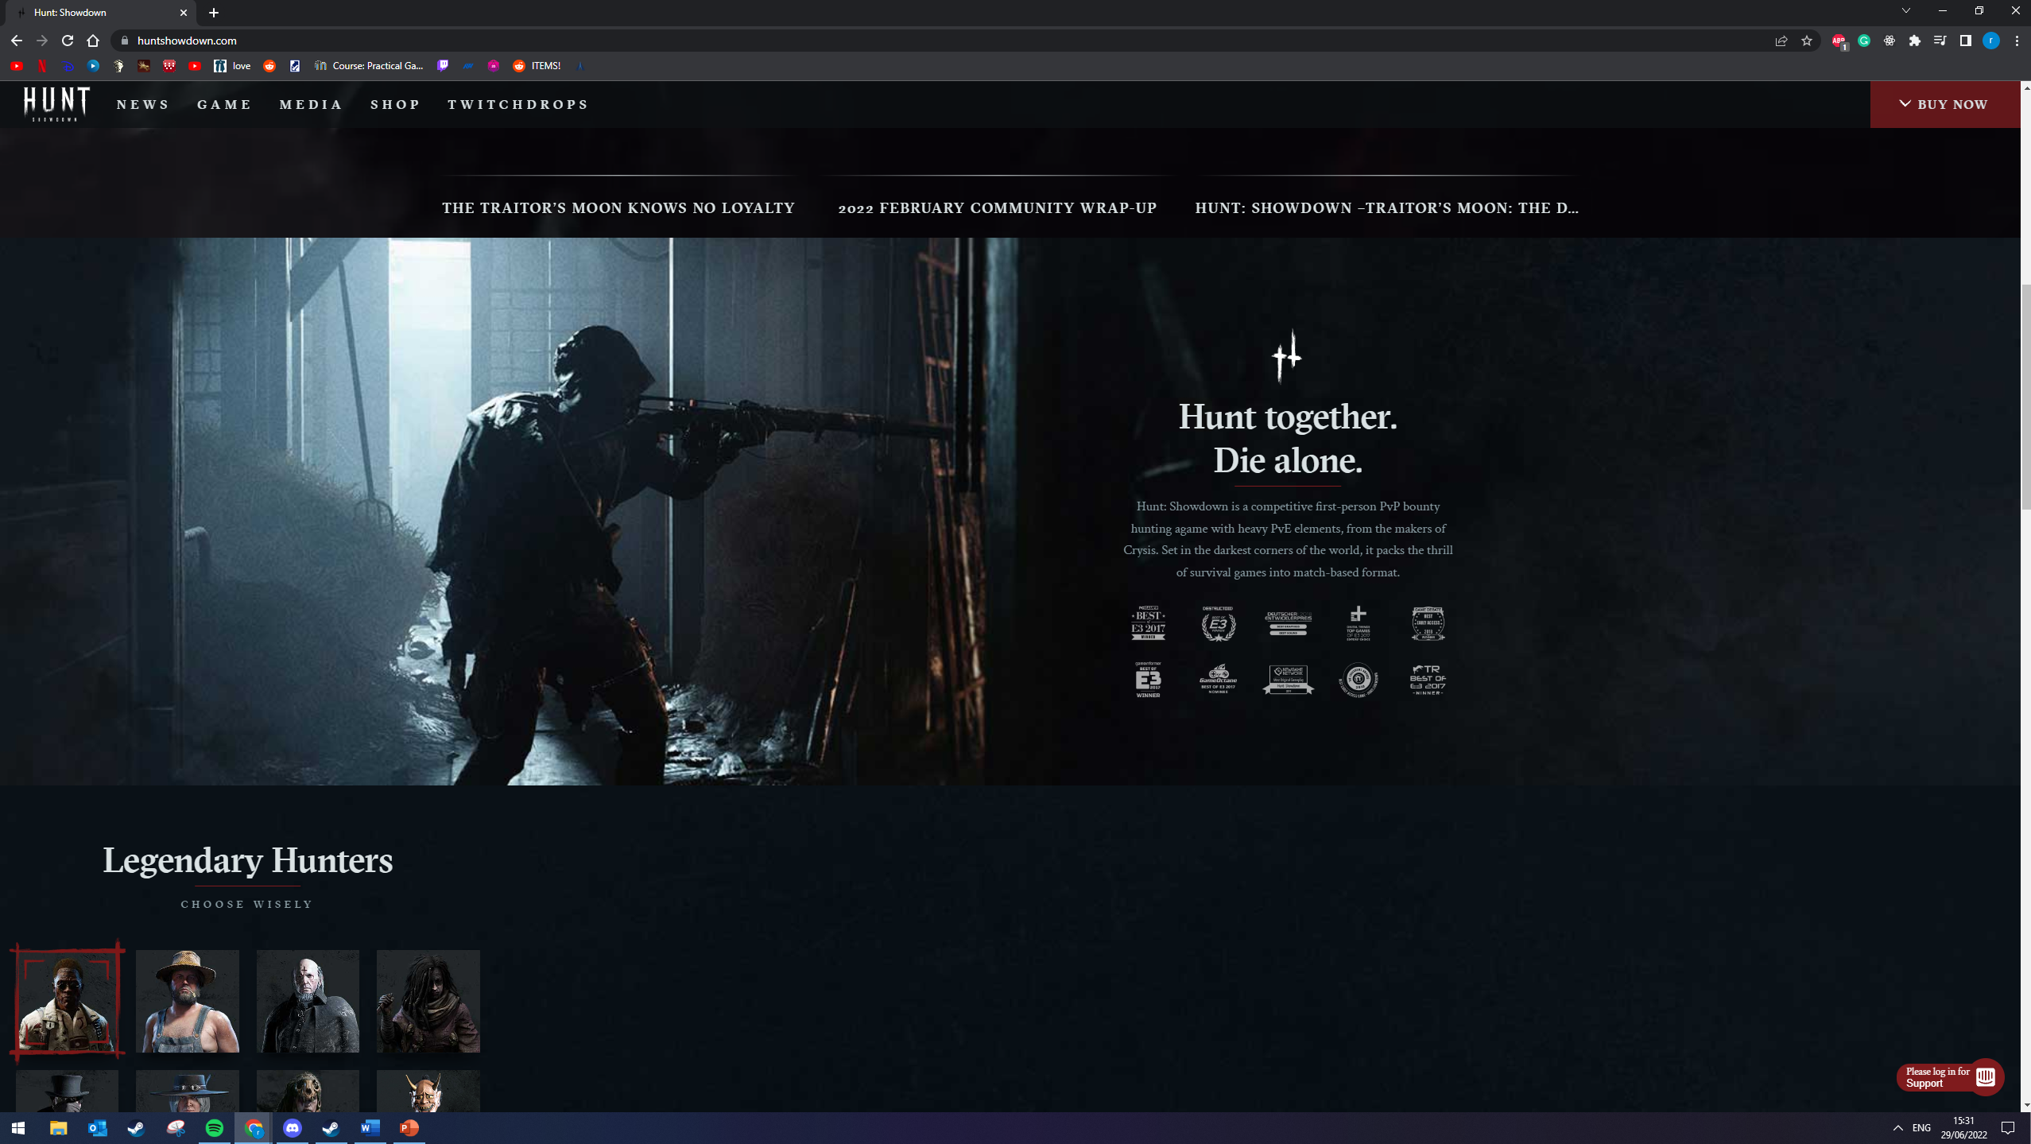

Slide 4
The game loop

Slide 6
Sound design

Slide 7
Look and feel

Slide 8
Bugs

Slide 9
Monetization

Slide 10
Player base

Slide 11
Outro

Slide 12
Gameplay

